Slide 1
Stock Horse Pleasure Pattern 1 for W/T
Gaits to be performed in this order:
Extended Walk
2Extended Trot
Trot
Extended Trot
Stop and Reverse
Walk
Trot
Extended Trot
Extended Walk
Stop and Back
Lengths will be adjusted based on arena size

Slide 2
Stock Horse Pleasure Pattern 1 W/T/L
Gaits to be performed in this order:
Extended Walk
Trot
Extended Trot
Lope
Stop and Reverse
Walk
Lope
Extended Lope
Trot
Stop and back
Lengths will be adjusted based on arena size

Slide 3
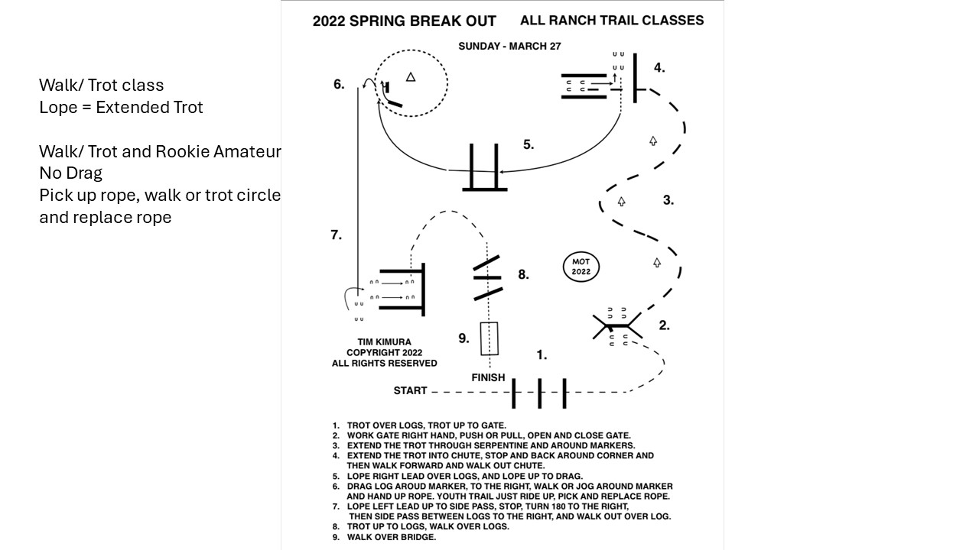

Slide 4
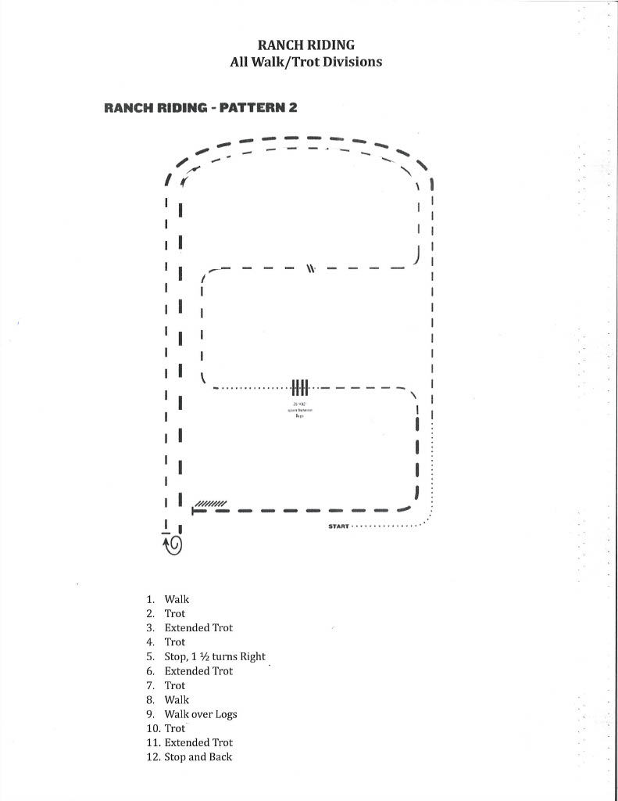

Slide 5
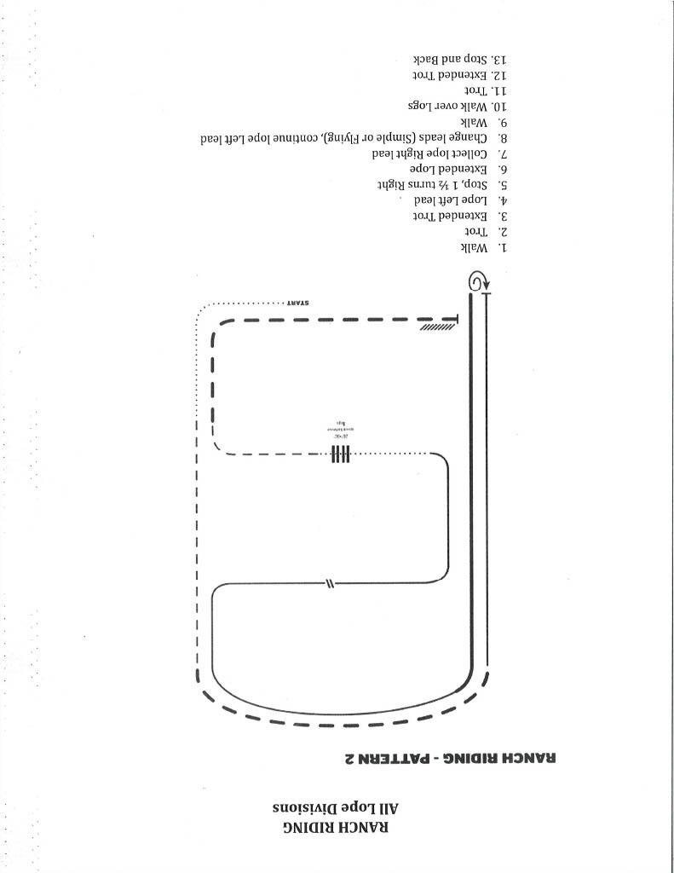

Slide 6
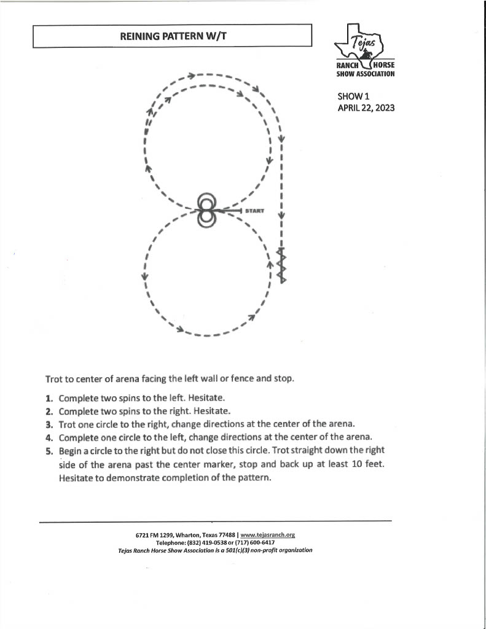

Slide 7
