Slide 1
Stock Horse Pleasure Walk/ Trot
Pattern Show 3 and 6
Walk
Trot
Extended Trot
Trot
Stop and Reverse
Extended Walk
Extended Trot
Trot
Extended Trot
Stop and Back

Slide 2
Stock Horse Pleasure Walk/ Trot/ Lope
Pattern Show 3 and 6
1.Walk
2.Lope
3.Extended Lope
4.Trot
5.Stop and Reverse
6.Extended walk
7.Trot
8.Extended Trot
9.Lope
10. Stop and back

Slide 3
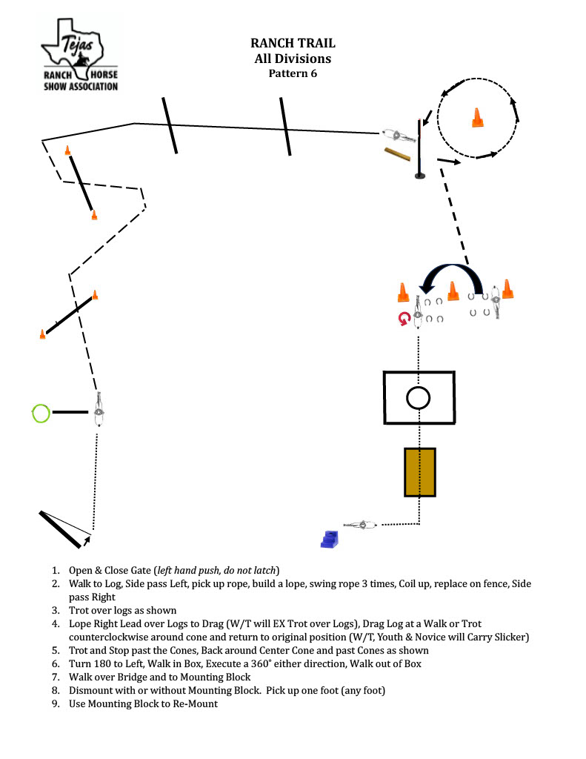
Walk/ trot do not remount/ walk horse in hand to exit

Slide 4
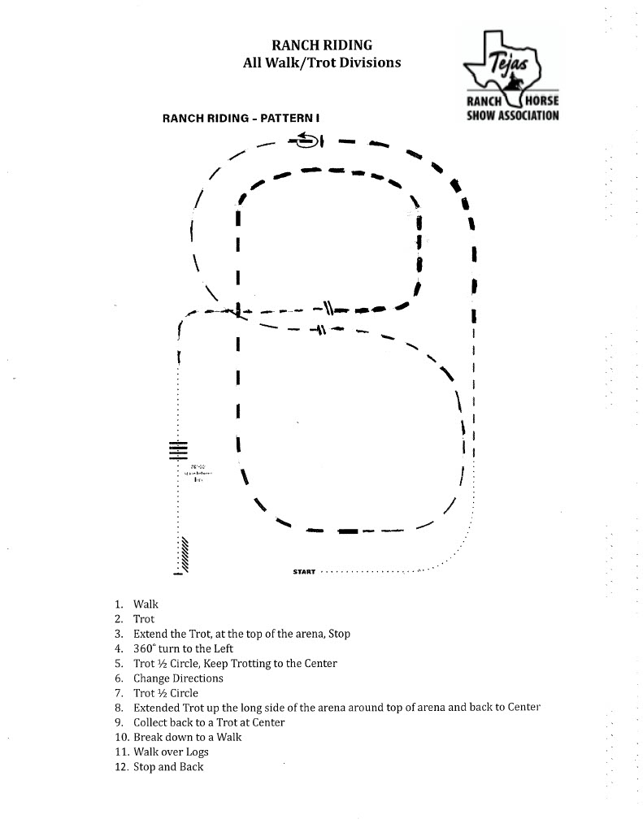

Slide 5
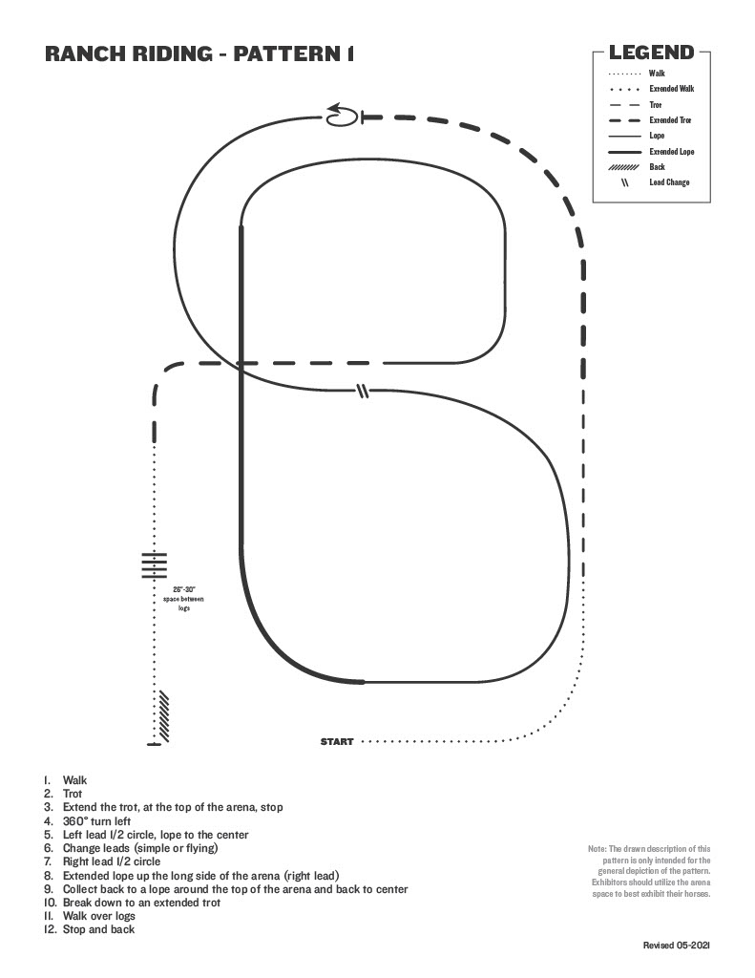

Slide 6
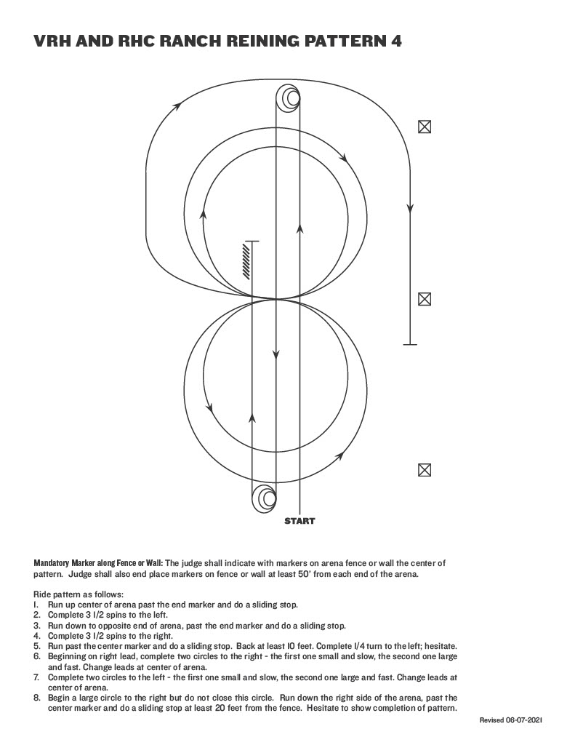

Slide 7
