Slide 1
Stock Horse Pleasure Walk/Trot
Pattern Show 2 and 5
Walk
Trot
Extended Trot
Trot
Stop and Reverse
Extended walk
Extended Trot
Trot
Extended Trot
Stop and back

Slide 2
Stock Horse Pleasure Walk/Trot/ Lope
Pattern Show 2 and 5
1.Walk
2.Lope
3.Extended Trot
4.Trot
5.Stop and Reverse
6.Trot
7.Lope
8.Extended Lope
9. Extended Walk
10.Stop and Back

Slide 3
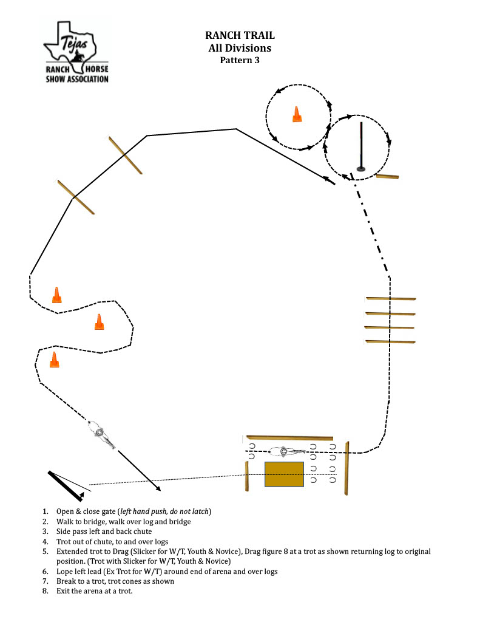
Trail Pattern Show 5

Slide 4
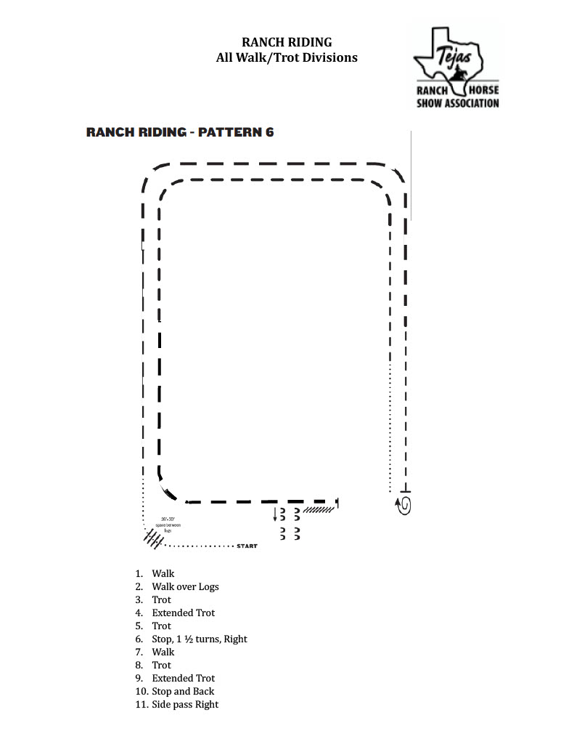

Slide 5
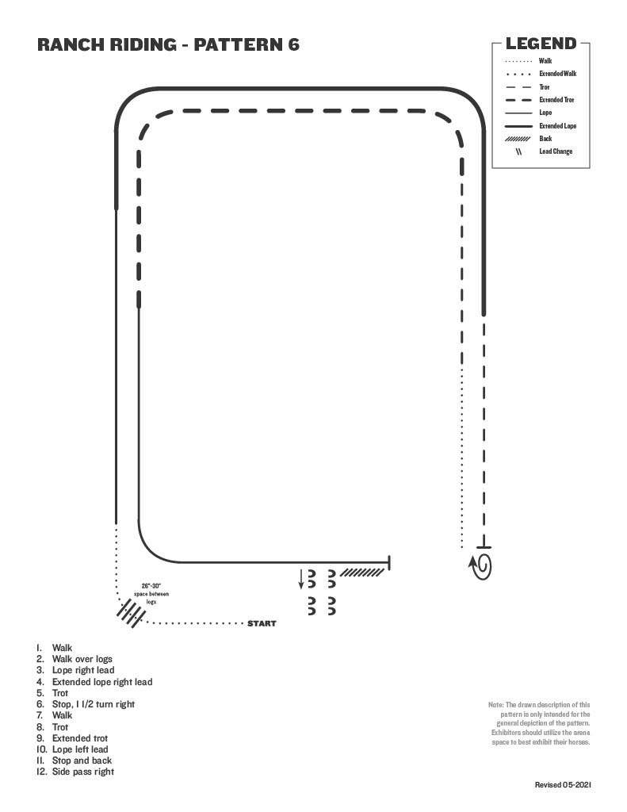
Walk/ Trot pattern
Lope=trot
Extended lope= extended trot
Walk/ Trot
Lope = Trot
Ext. Lope = Ext. Trot

Slide 6
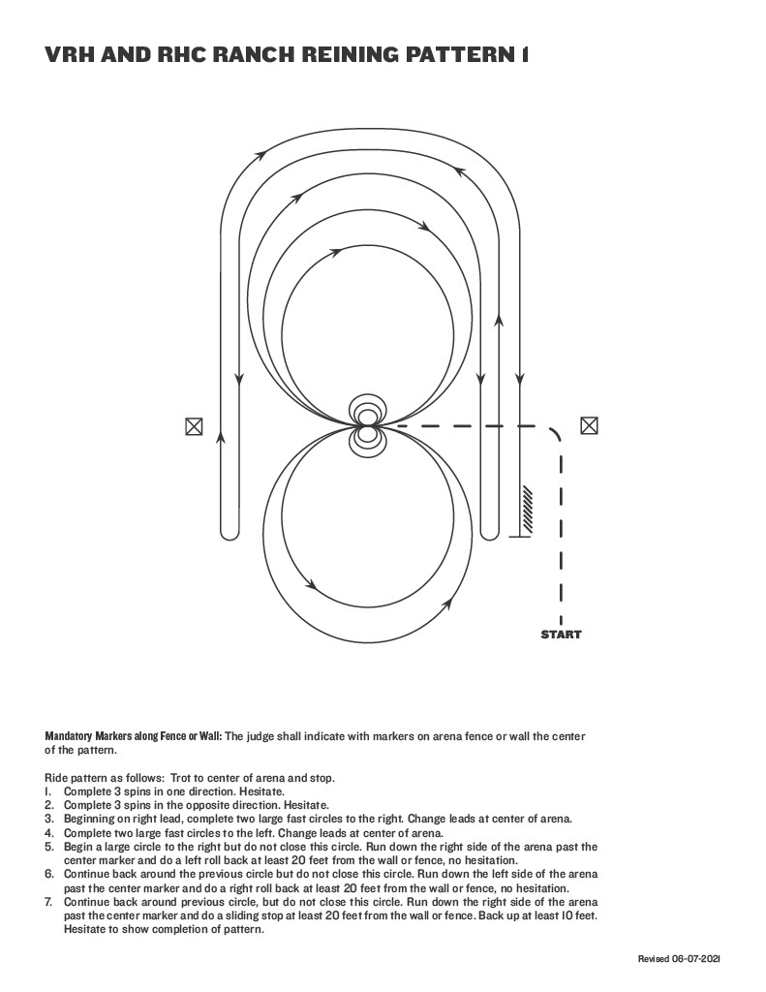

Slide 7
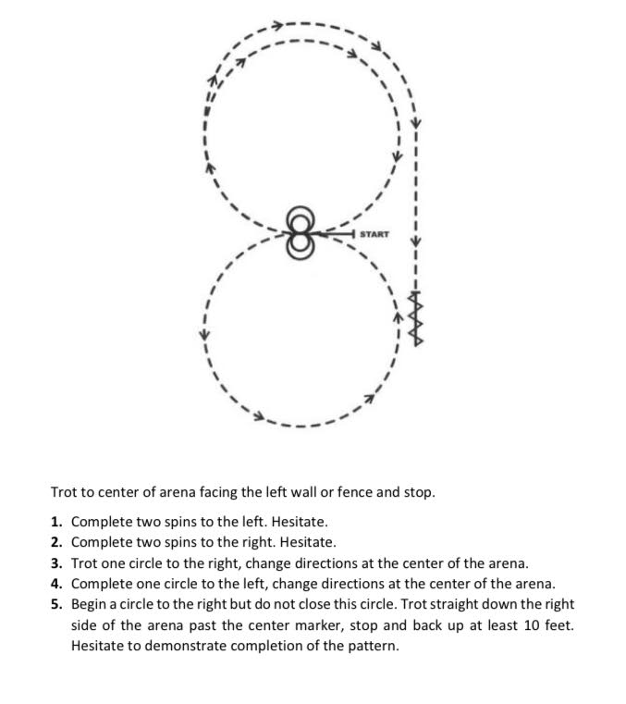
REINING PATTERN W/T
SHOW 1
APRIL 22, 2023
P.O. Box 1254, Needville, Texas 77461 | www.tejasranch.org
Telephone: (832) 419-0538 or (717) 600-6417
Tejas Ranch Horse Show Association is a 501(c)(3) non-profit organization

